Slide 1
Jailbreaking iOS

Slide 2
Overview
Jailbreaking concept
Example of Jailbreaking iOS

Slide 3
Jailbreaking Concept

Slide 4
What is Jailbreaking?
The term "jailbreak" is the process by which full execute and write access is obtained on all the partitions of iOS, iPadOS, tvOS and watchOS. It is done by patching ~/private/etc/fstab to mount the System partition as 'read-write’ instead of read only.
Jailbreaking permits root access to the iOS file system and manager, allowing the download of additional applications, extensions, and themes that are unavailable through the official Apple App Store.
In order to achieve this when a device is booting, it loads Apple's own kernel initially, so a jailbroken device must be exploited and have the kernel patched each time it is booted up.

Slide 5
How does Jailbreaking work?
Jailbreaking allows you to get control over the root and media partition of your device. This is where all the iOS files are stored. To do this, ~/private/etc/fstab must be patched.
fstab is like a switch that controls permissions to the root and media partitions. By default, this is set to a 'read-only' mode allowing you to only view but not make any changes. To be able to make modifications, jailbreaking sets the fstab to 'read-write' mode.

Slide 6

What is fstab?
fstab is your operating system’s file system table. In the past, it was the primary way that the system mounted files. Nowadays, when you plug in a USB it’ll just pop up automatically in Windows and Mac OS, but back then you had to manually mount those disks to a specific folder using the “mount” command.

Slide 7
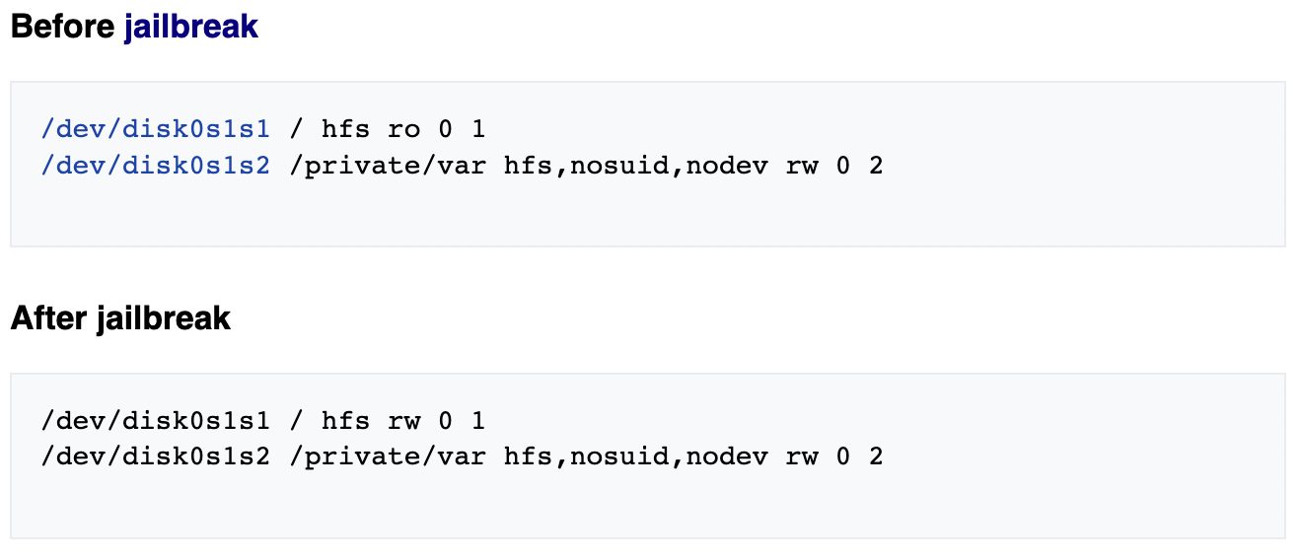
How does Jailbreaking work? (2)
Since fstab controls the read/write access of the root and media partitions. The most barebones jailbreak can be put in place simply by modifying this file to grant full read/write access to the root partition (/dev/disk0s1s1).
Read only
Read / Write

Slide 8

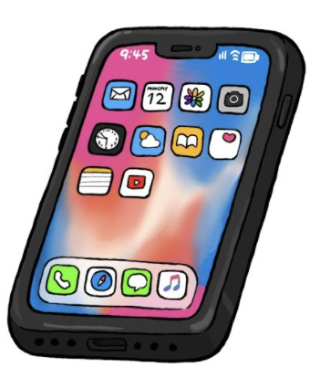
Types of jailbreaks
An untethered jailbreak is a process where a jailbreak is achieved without the need to use a computer. As the user turns the device off and back on, the device starts up completely, and the kernel is patched without the necessity of a computer.
Notes:
https://www.appknox.com/blog/how-does-jailbreak-work

Slide 9
Types of jailbreaks (2)
With a tethered jailbreak, a computer is needed to turn the device on each time it is rebooted. If the device starts back up on its own, it will no longer have a patched kernel, and it may get stuck in a partially started state. Basically, the purpose of the computer is to "re-jailbreak" the phone each time it is turned on.

Slide 10
Types of jailbreaks (3)
Only needs to be tethered when rebooted.
A semi-tethered solution is when the device boots, it will no longer have a patched kernel, which means you will not be able to run any modified code. But it can be used for normal functions. When you need to use features that require a modified code to run, the user must start the device with the help of a jailbreaking tool.

Slide 11
Types of jailbreaks (4)
A semi-untethered jailbreak is a type of jailbreak like a semi-tethered jailbreak in which when the device reboots, it no longer has a patched kernel, but the key difference is that the kernel can be patched without using a computer. The kernel is usually patched using an application installed on the device without patches.

Slide 12
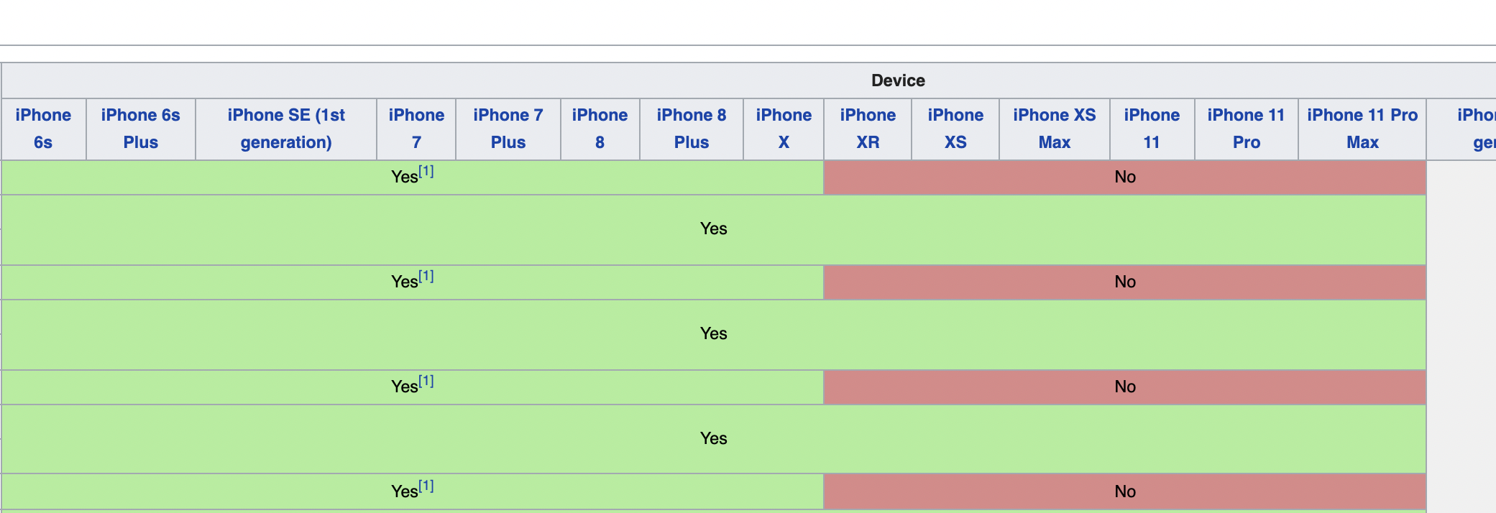
Device/Software Compatibility
Before jailbreaking, iOS software, available devices and available jailbreak software must match before attempting.
Full list: https://www.theiphonewiki.com/wiki/Jailbreak#Versions

Slide 13

Example of Jailbreaking

Slide 14
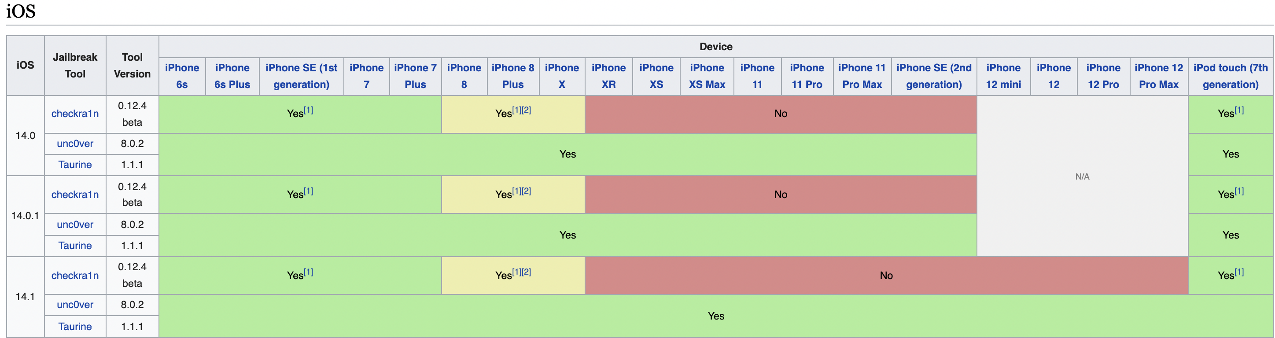
Jailbreak Step 1
Determine target iPhone Model + iOS version
For this example, an old iPhone XS running iOS 14.0.1 will be used.
Determine available jailbreak software.
Head to: https://www.theiphonewiki.com/wiki/Jailbreak#Versions

Slide 15
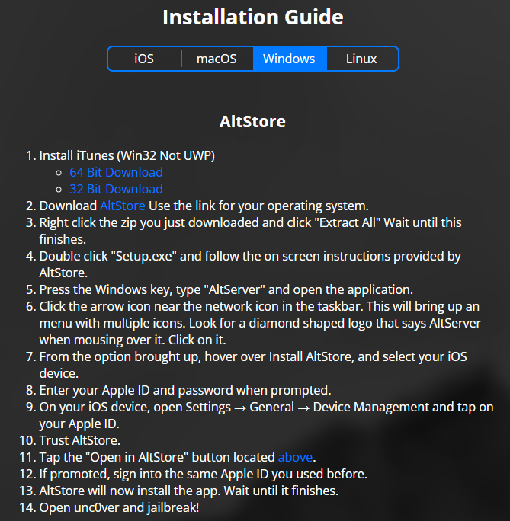
Jailbreak Step 2
After determining compatible iOS version and Jailbreak Software, head to the jailbreak site for more specific instruction.
In this example, unc0ver will be used.
Follow the installation guide:

Slide 16
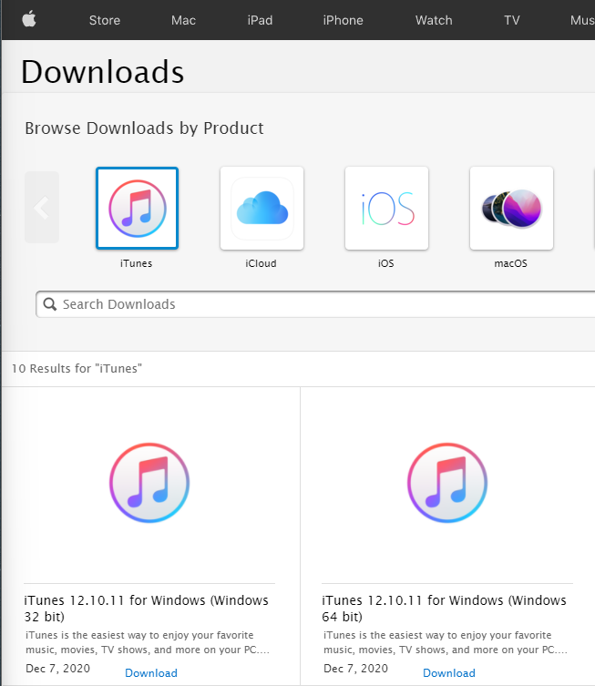
Jailbreak Step 3
Download iTunes from Apple. Not Windows Store Version.
www.support.apple.com/downloads/itunes
Run through the set up and proceed to the next step.

Slide 17
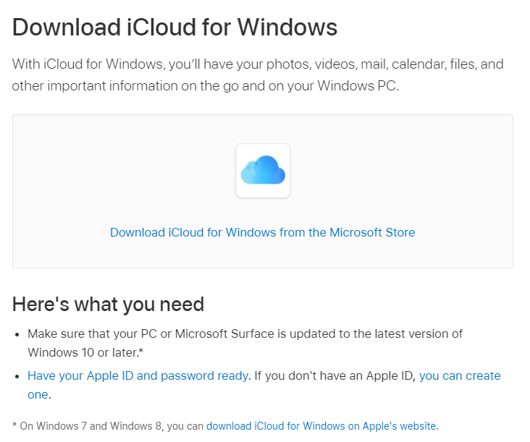
Jailbreak Step 4
Download iCloud from Apple. Not Windows Store Version.
https://support.apple.com/en-us/HT204283
Run through the set up and proceed to the next step.

Slide 18

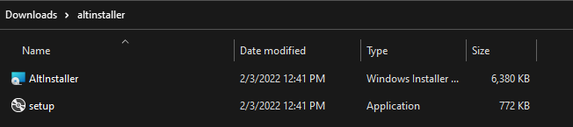
Jailbreak Step 5
Download AltStore, Unzip and Install.
www.altstore.io
Launch setup

Slide 19

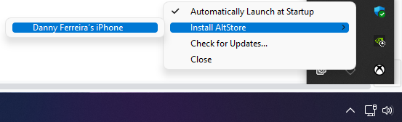

Jailbreak Step 6
Attach iPhone to computer with USB to lightening cable.
In the lower right corner, click the arrow icon near the network icon in the taskbar.
1
Install to tethered iPhone
3
Click on the AltStore Icon
2

Slide 20
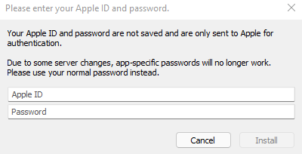
Jailbreak Step 7
Enter your Apple ID and password when prompted.
This will allow an unverified by Apple application to be installed on your device.

Slide 21

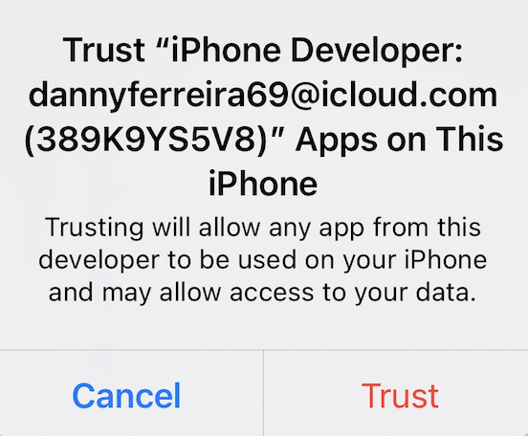
Jailbreak Step 8
Apple ID Here
On your iOS device, open Settings → General → Device Management and tap on your Apple ID.
Hit Trust

Slide 22
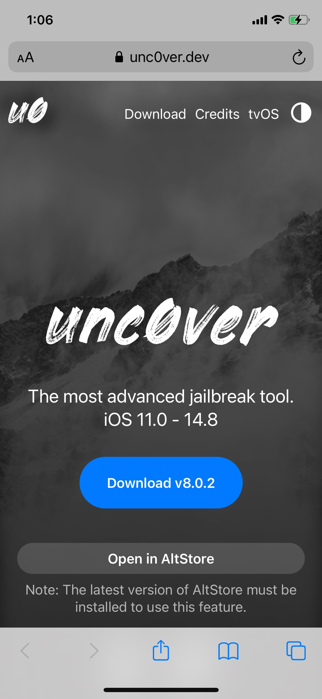

Jailbreak Step 9
Go to Safari on target iPhone and visit unc0ver.dev
Select Open in AltStore
If prompted, log in with iCloud account again.

Slide 23
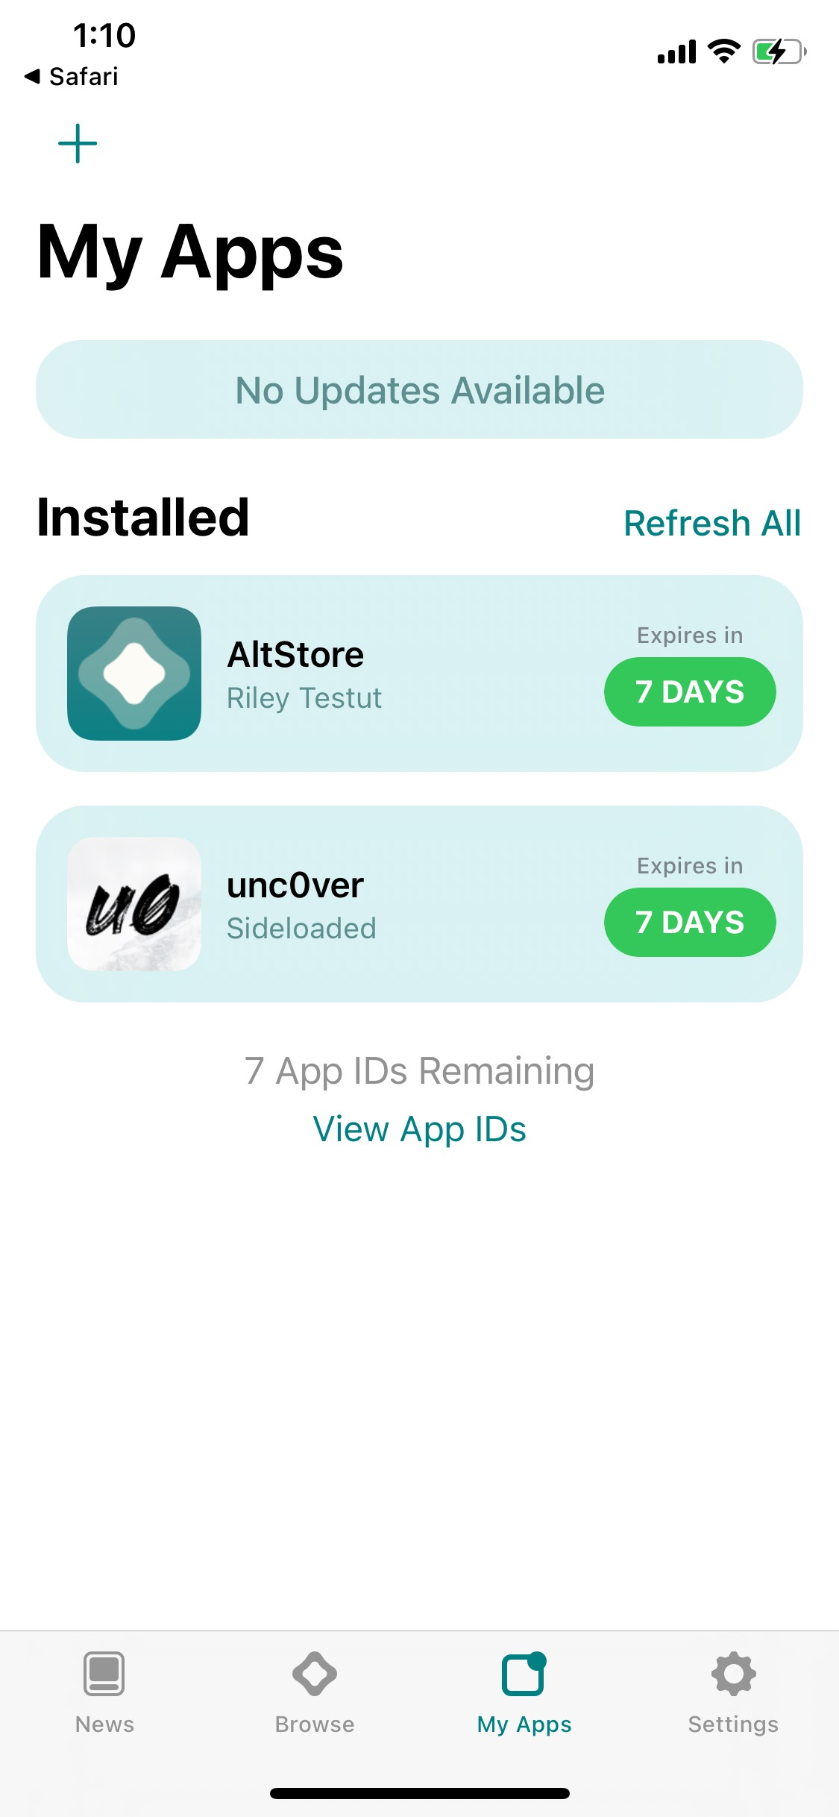
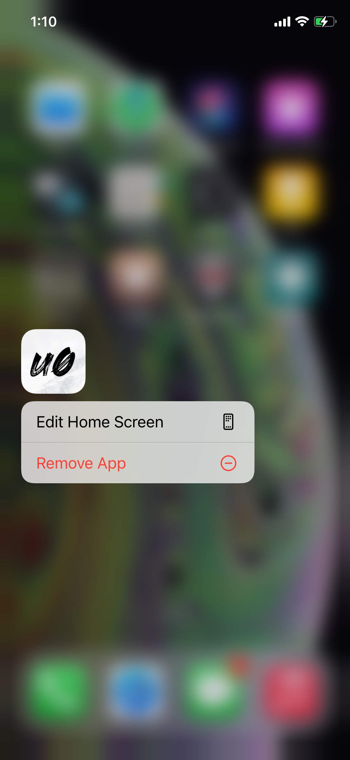
Jailbreak Step 10
AltStore will now install the app. Wait until it finishes.
Open unc0ver once installed.

Slide 24
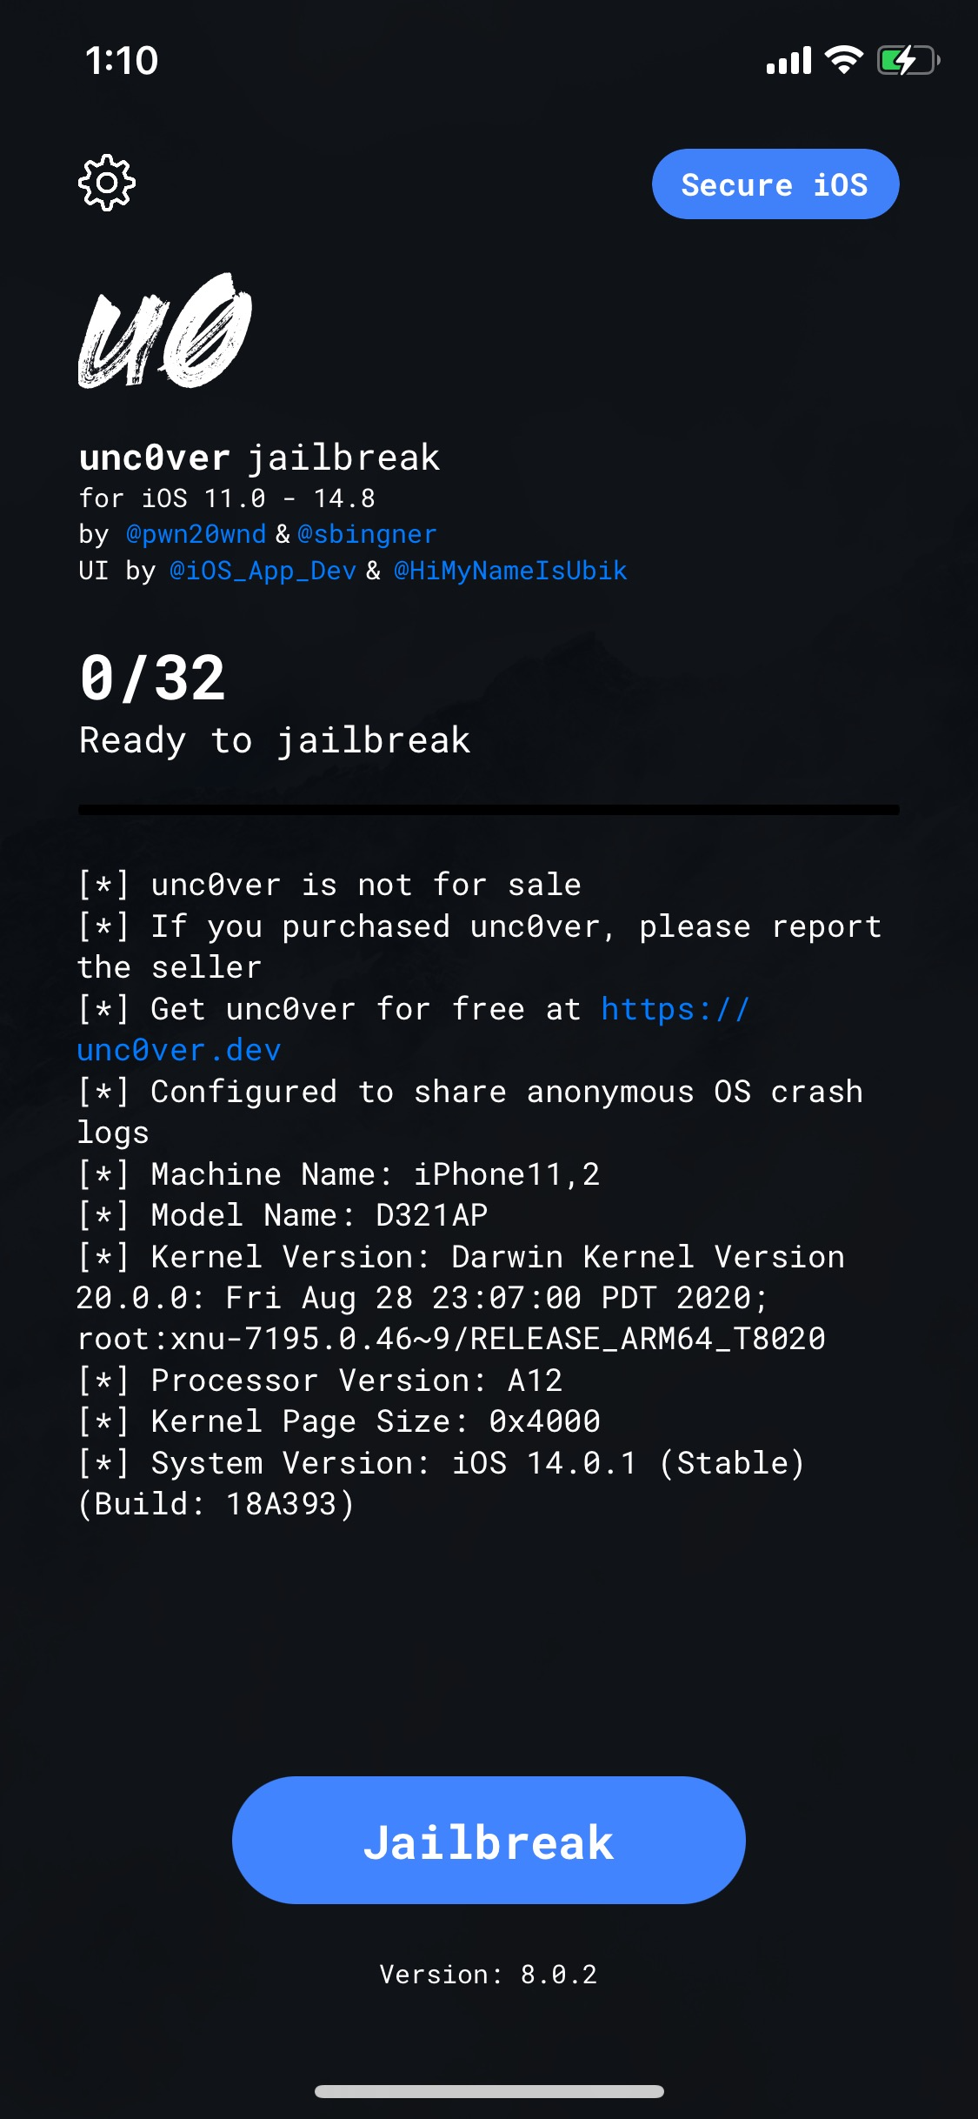
Jailbreak step 11
Hit the Jailbreak button to proceed.
This may take between 5 to 10 minutes.

Slide 25
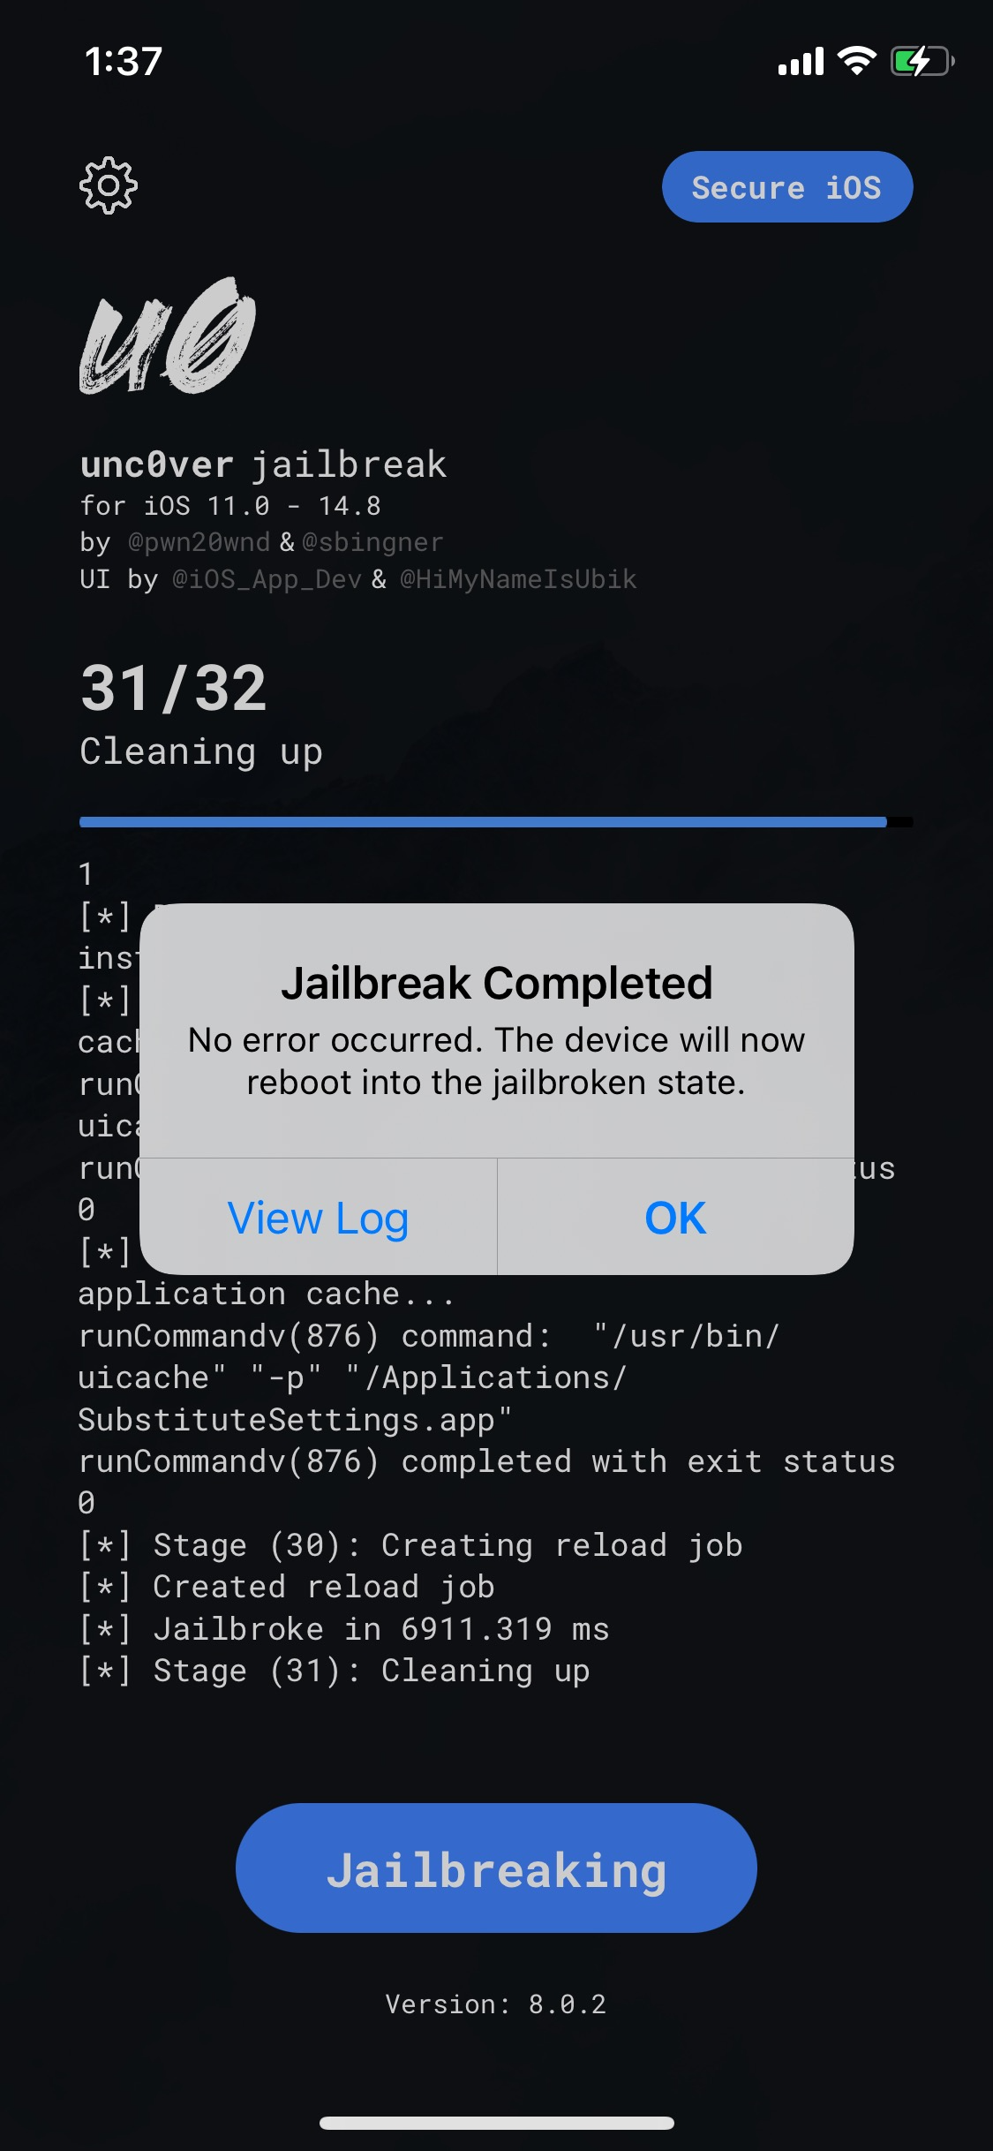
Jailbreak step 12
Jailbreak software will return with a complete notification if successful.
Hit ok to reboot the device into the jailbroken state.
Upon rebooting, Cydia will now be installed.
Complete.

Slide 26
Summary
Overview of the Jailbreaking Concept
Example of Jailbreaking iOS

